Slide 1

Intro to Pathplanner
By:Team1599

Slide 2
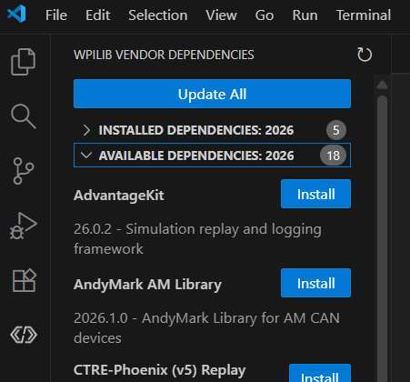
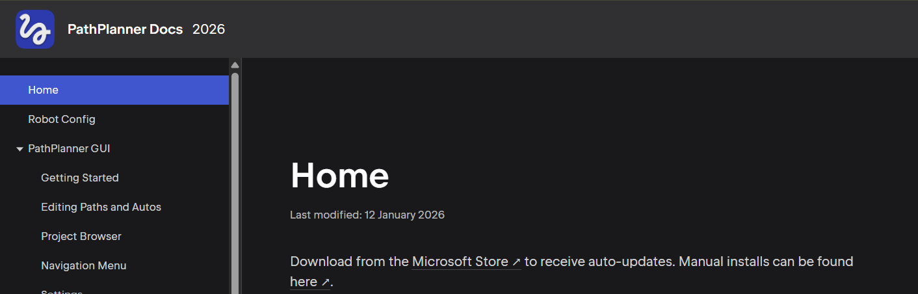
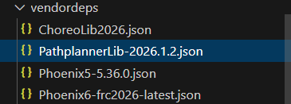
Getting started
Download the Pathplanner application can be found in the Pathplanner Docs
Find and Download Pathplanner lib in Vscode
The Wpilib logo found on the left side of Vscode in your open project is where you can download the Pathplanner lib.
Pathplanner Docs
The Lib should show up under vendordeps after downloading

Slide 3
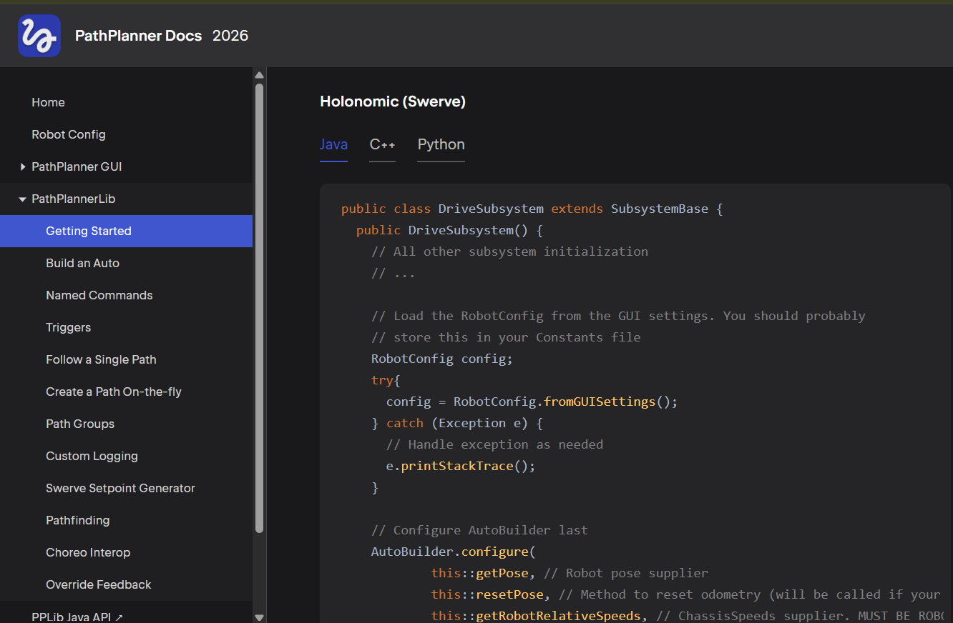
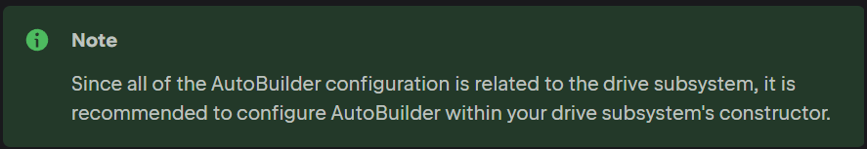
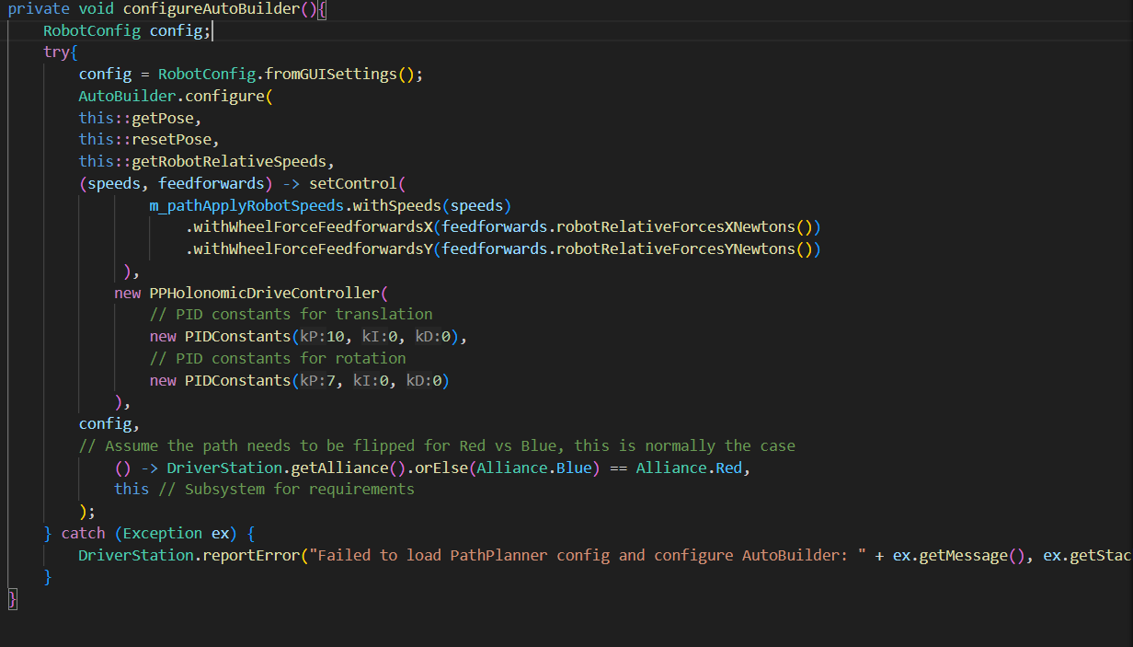
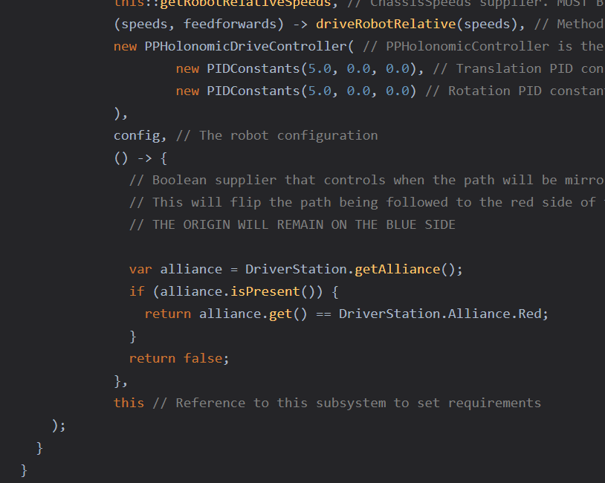
Drive Code
Under Getting Started in the pathplanner docs you will find both swerve and tank example code
Copy and paste this code into the correct parts of your Drive subsystem class
Team 1599 example code
Note: team 1599’s code is arranged differently then the docs but works the same
The red boxes show the different parts of the code that go in separate functions/commands

Slide 4
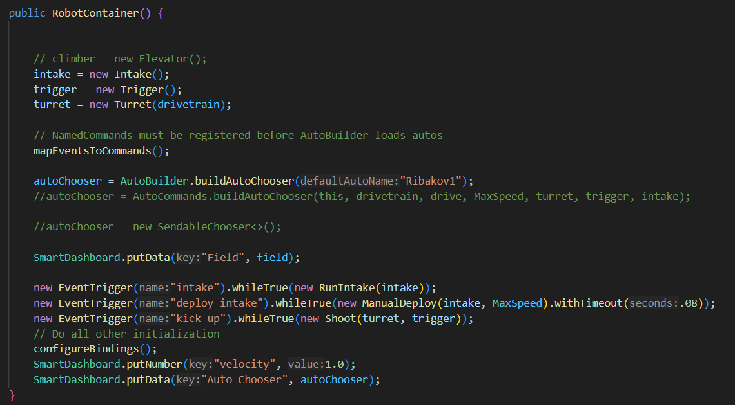
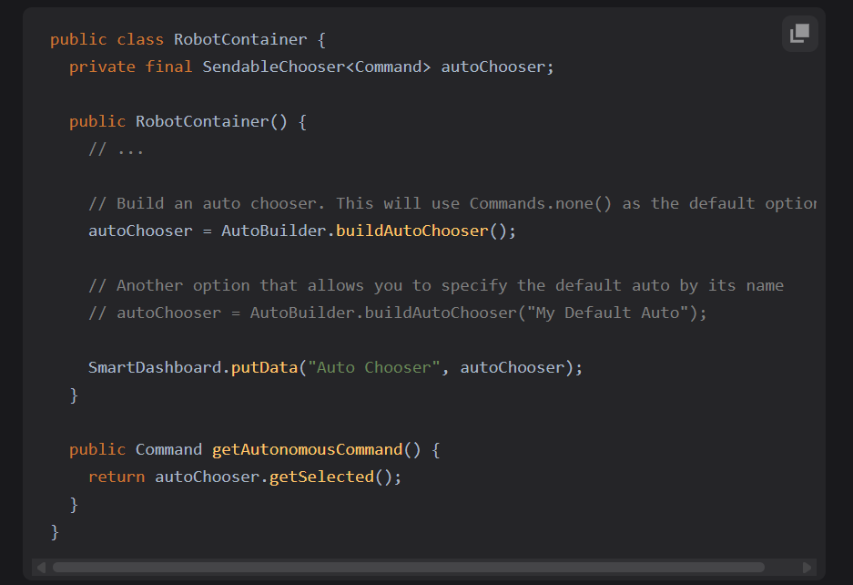
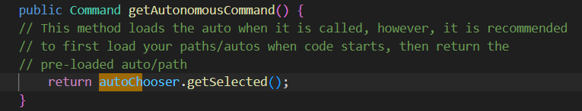
Auto Selector
Sendable chooser is also known as your auto selector
Your sendable chooser sample code can be found in the getting started tab of the Pathplanner DOCs
Make sure to copy and paste the code into the correct parts of your robot container
More 1599 example code
The red boxes show the different parts of the code that go in separate functions/commands

Slide 5
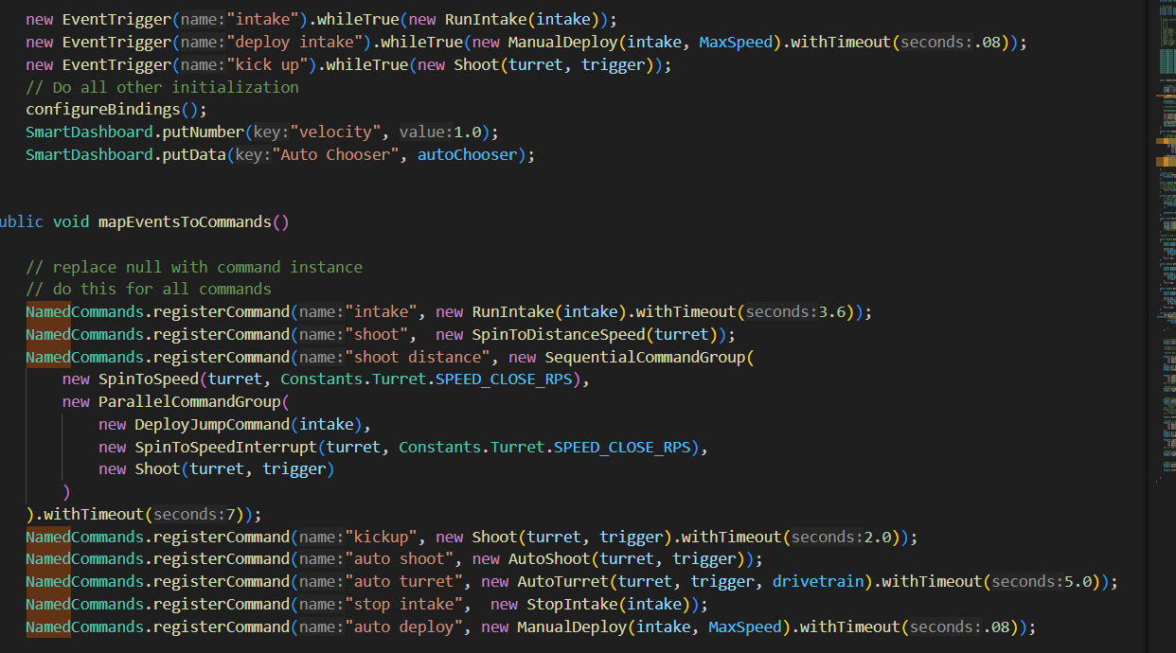
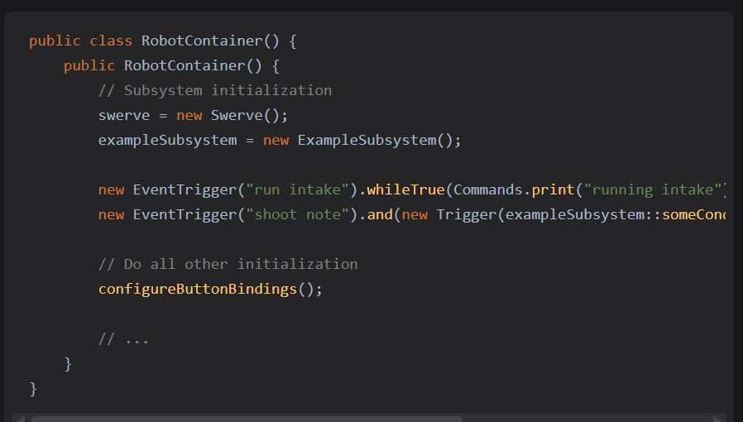
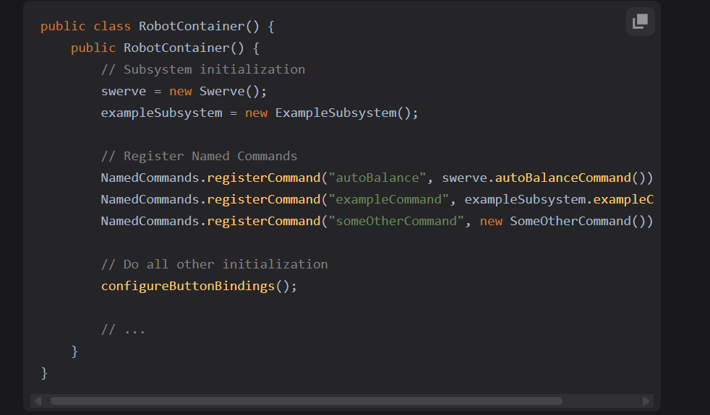
Event Command/Triggers
More 1599 example code
Named Commands and Event Triggers are commands you can add on to paths or autos
Both named commands and event trigger example code are found under their respective tabs
When creating named commands and event triggers it is important that the name is the same in code
Your Triggers/Commands will vary based off of what your robot does.

Slide 6
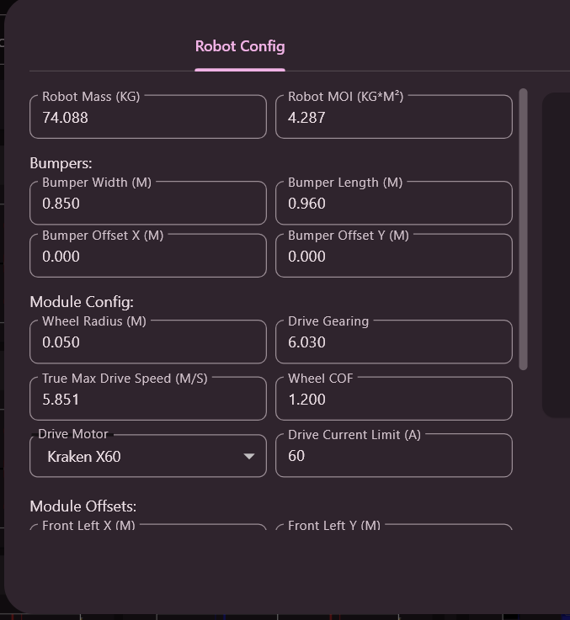
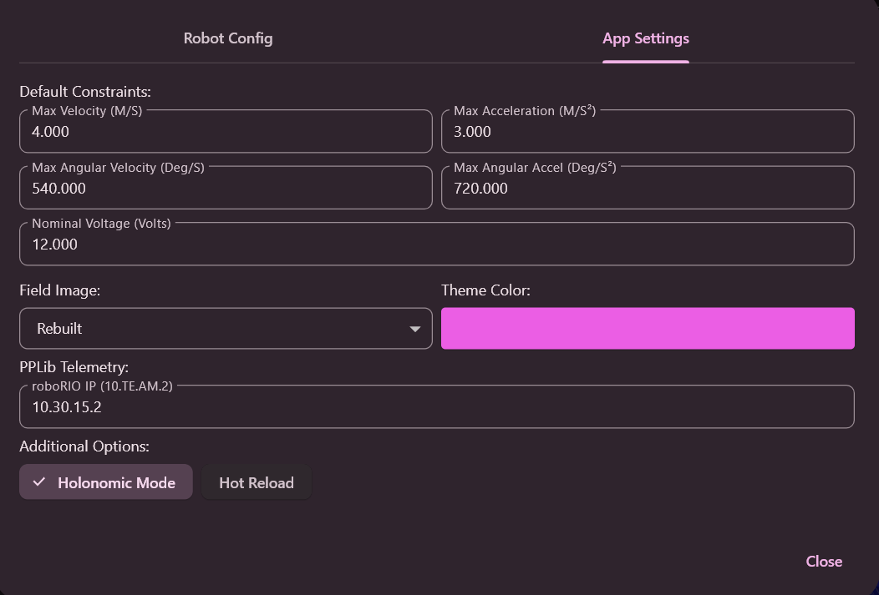
Using the Pathplanner App
When you create your pathplanner project folder place it inside of your deploy folder
The first thing to do when you open pathplanner is set up your robot configs
The settings button is located on the left side of the screen that's where you can change your configs
There are more editing options in the app settings

Slide 7
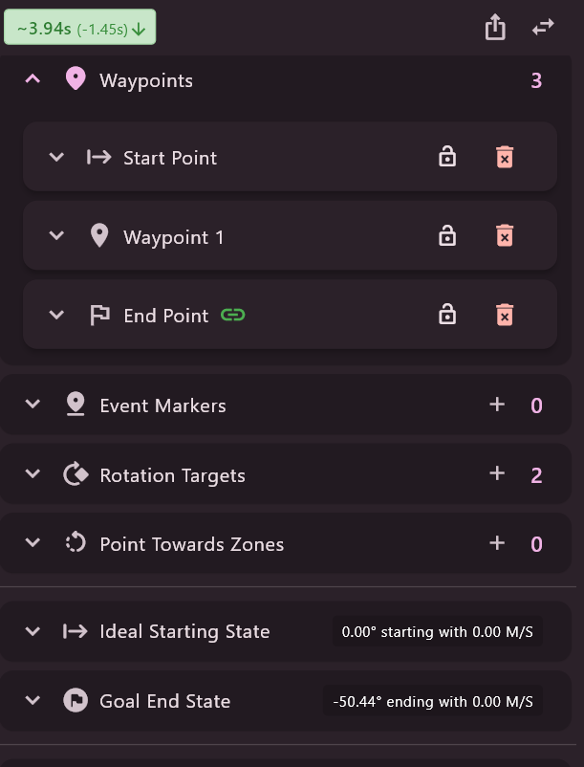
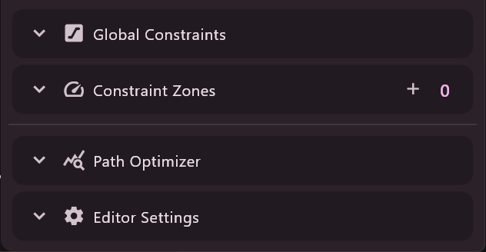
Explaining the tools
Waypoints are points used to tell the robot where to go
To add a waypoint double click on the field
Event markers are used to run commands at a specific point in the path
Rotation targets are a point that changes the robots angle
Point towards zones allow for the robot to face a specific point on the field
Ideal starting state sets the angle the starting point is at
The Goal End State sets the angle the end point is
Global Constraints change things like max velocity for the whole path
Constraint Zones add constraints to certain parts of the path
The path optimizer changes your path to be faster
Editor settings just changes different tools to help with path making

Slide 8
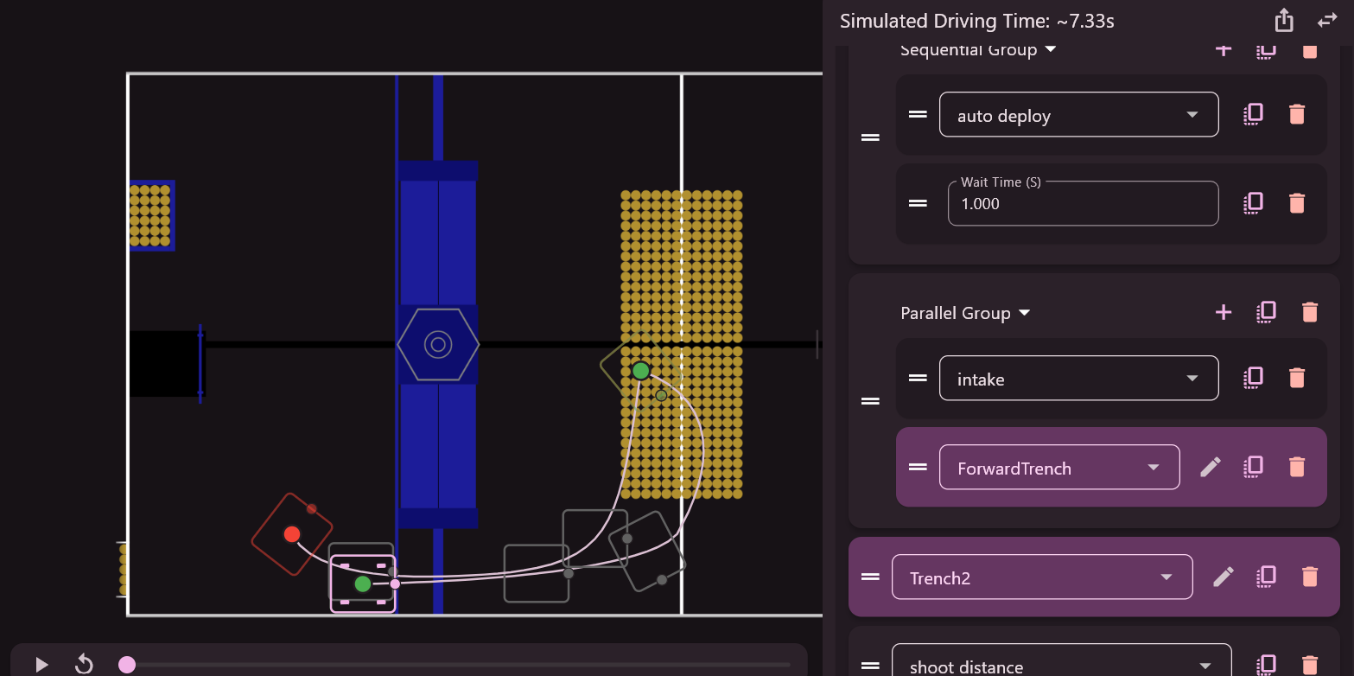
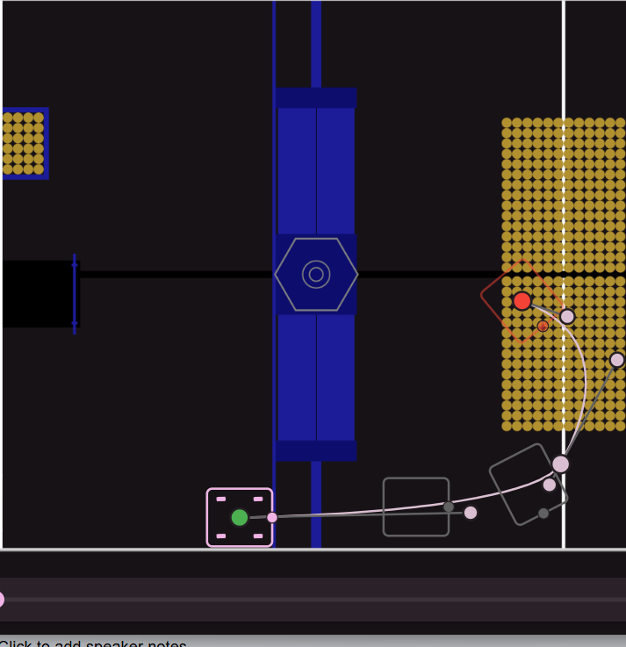
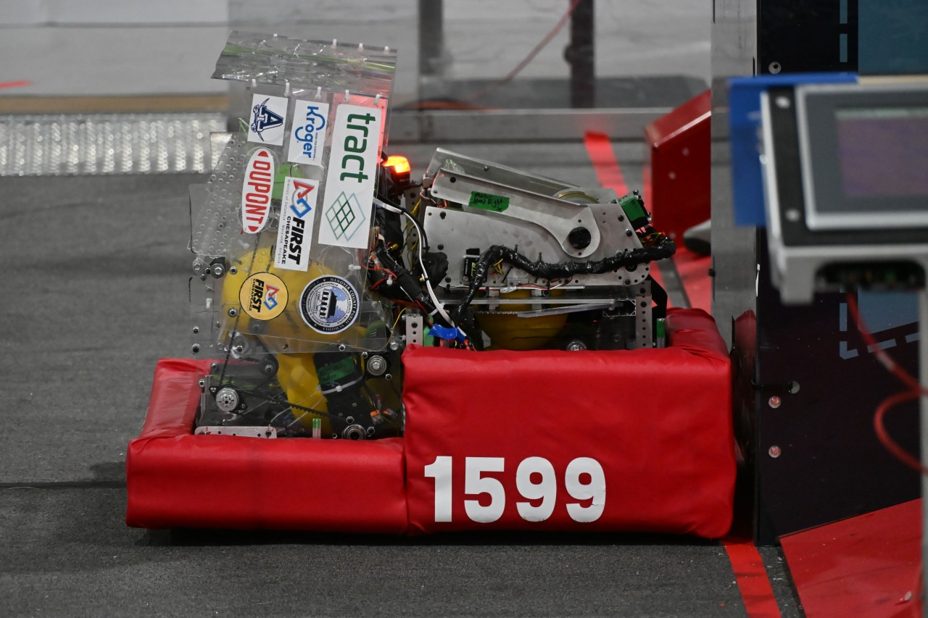
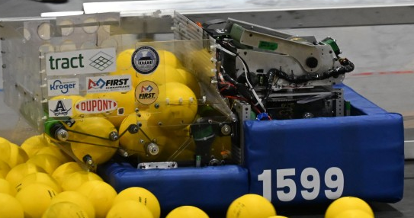
Things to think about
Before you start your path
What side of your robot is front?
What are the functions of your robot?
Is there any part of the the robot that extends over your bumpers?
Do you know the rules?
Pathplanner uses paths which are segments that you put together to make a full auto. Paths are very useful as the longer the auto the harder it is to control how the robot moves so by separating the auto into sections helps make an auto that is easier to control and tweak down the line
This is the path that makes up the first part of the auto above
This is team 1599 robot for this year in starting pos Our robot has an over the bumper intake that has to be accounted for in the auto.

Slide 9
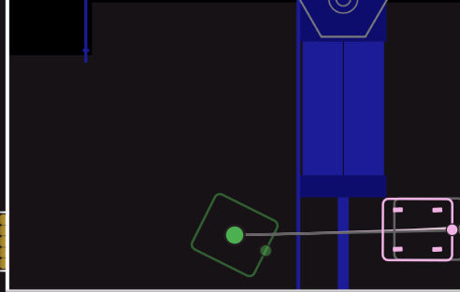
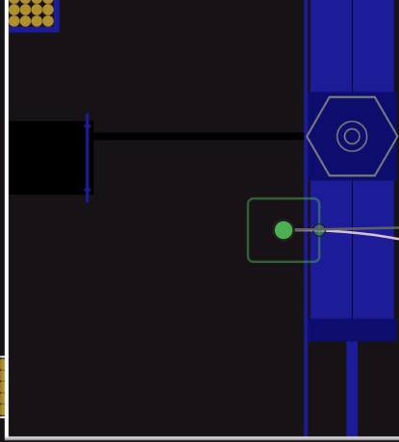
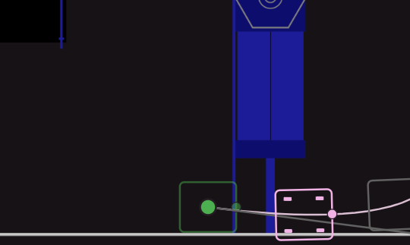
While making your path
Bad Path Illegal start
Planning out your auto
How many paths will it take?
What's the goal of the auto?
What will other teams be doing?
Making your Auto
Make sure your starting POS is easy to set up
Make sure some part of your robot is on the Black line
Account for any overhanging mechanisms
Make sure the robot is not clipping through the field
Try to be as efficient as possible
Not an easy set up could be hard for field set up accuracy
The robot is clipping through the wall
Easy field set up and there's ample room for the robot and the overhanging intake.The red box shows the space between the trench and the intake

Slide 10
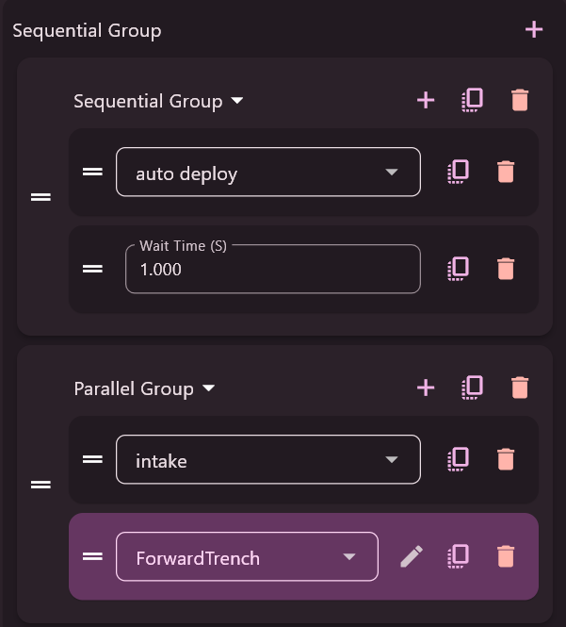
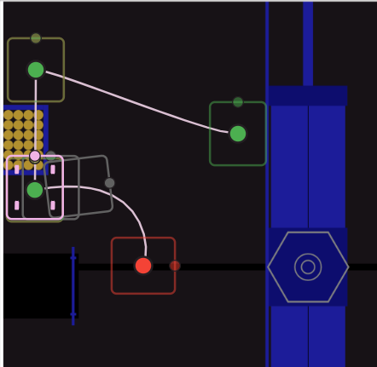
Forming your Auto
Command Groups
Groups are used to make sure different things run when they are supposed to
Parallel groups run anything in it at the same time
Sequential groups run anything in it one after another
Named Commands
Named commands can be used before after or throughout a path
Team 1599 prefers Named commands over Event triggers due to having issues with the triggers.
Always test your autos and commands

Slide 11

Thank You

